Slide 1
Green University of Bangladesh
Computer Science and Engineering
Name : Nazifa Alam Nowrin
ID : 193002103
Topic : Nuclear Power Plant in Bangladesh

Slide 2
Presentation Outlines:
Nuclear Power Plant
Importance of Nuclear Power Plant in Bangladesh
Rooppur Nuclear Power Plant (RNPP)
Pros and Cons of Nuclear Power
Conclusion

Slide 3
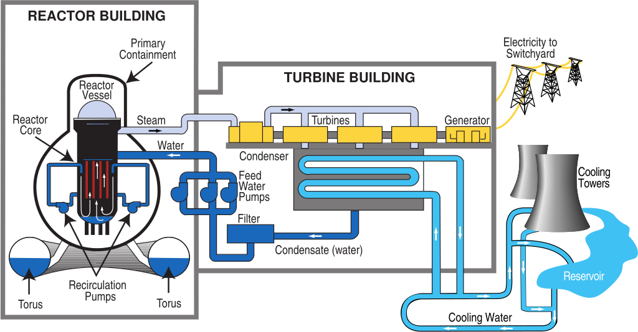
Nuclear Power Plant :
A generating station in which nuclear energy is converted into electrical energy is known as a nuclear power station.

Slide 4
Importance of Nuclear Power Plant in Bangladesh :
Rapidly increasing electricity demand
Need huge amount of electrical energy
Require alternative fuel

Slide 5
Ruppur Nuclear Power plant:
In 1961, first proposed to build a nuclear power plant.
Accordingly that year govt. acquired 253.90 acre of land in Ruppur in pabna district.
In 1963, the plant was approved.
After the independence in 1974 Bangladesh govt. started discussion with Russia, which was not successful.
Finally , in February 2011, Bangladesh got an agreement with Russia to build RNPP.

Slide 6
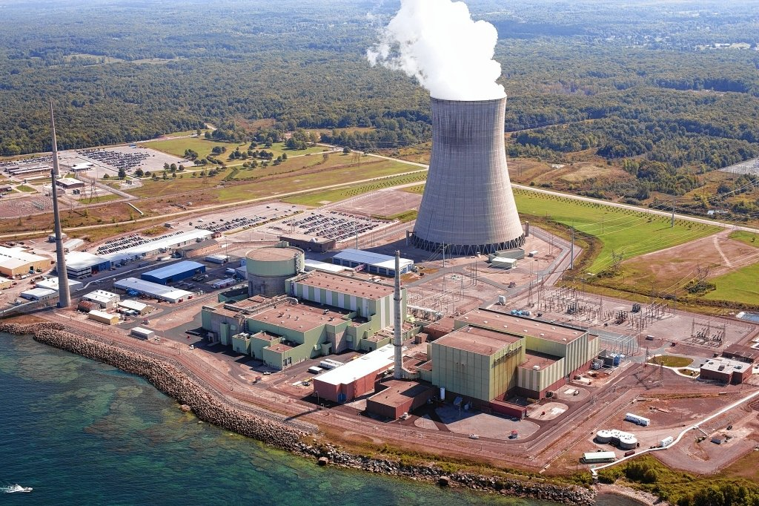
RNPP at a Glance:
Capacity: 2400MW with two units of 1200 MW each.
Generation of Reactor: GEN-III+
Fuel: 235 Uranium Dioxide
Construction by: Sate Atomic Energy corporation , Rosatom, Russia.
Cost of the project: $12.65 billion
Longevity: 60 years and extend to another 20 years.

Slide 7
Pros and Cons:
Pros Cons
Fuel required is quite small Fuel is expensive
Nuclear power plant requires less space Capital cost is very high
Very economical for bulk electric power Requires greater technical knowledge
Ensure continued supply of electrical energy

Slide 8
Conclusion:
Overall, Nuclear energy can be beneficial for our country.
Nuclear energy is indispensable: it is the only energy able to produce base load electricity massively and competitively without greenhouse gas emission.

Slide 9
Any Question?

Slide 10
Thank you

